Slide 1
Programming Fundamentals using C

Slide 2
Contents
Why should you study this course?
Prerequisites
Course Objectives
Course Description and Course Plan
Materials/ References/ Tools
Course Rules
Evaluation Strategy
How to study
Academic policy
Install tools for programming

Slide 3
Why should you study this course?
Foundation of Programming: C is often considered the “mother” of modern programming languages. Many languages, like C++, Java, C# and Python, have roots in C, so learning it provides a solid foundation.
Performance: C is a low-level language that allows for fine control over system resources and memory management, leading to high-performance applications.
System-Level Programming: C is widely used in system programming, including operating systems and embedded systems.

Slide 4
Why should you study this course?
Rich Library Support: C has a vast standard library, providing numerous built-in functions that can simplify development tasks.
Problem-Solving Skills: Learning C enhances your problem-solving skills as it often requires a deeper understanding of algorithms and data structures.
Community and Resources: C has a long-standing community, offering a wealth of resources, tutorials, and forums to help you learn and fix bug source code.

Slide 5
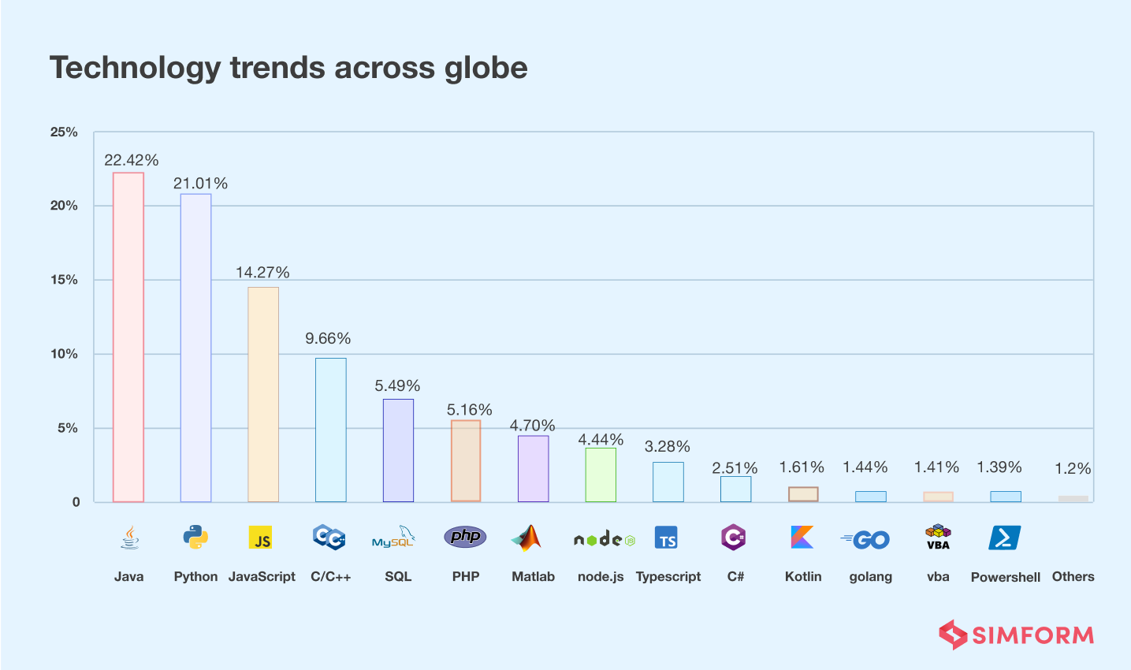
Why C is chosen?
Top ten common programming languages:

Slide 6
Prerequisites
Requires knowledge such as:
English reading comprehension
Basic logical thinking in mathematics

Slide 7
Course Objectives
Explain the way to solve a real problem using computer.
Understand the basic concepts computer system, and software development.
Understand the basic concepts of programming, focus on procedure programming, testing and debugging, unit testing.
Read and understand the simple C programs.
Solve real problems using C.
Individual and team work behaviors.

Slide 8
Course Description
Introduction to PFC
Basic Computation
Basic Logic constructs
Modules and Functions
Pointers
Libraries
Contiguous Storage using Arrays and Struct
Strings
Working to file: Text and Binary files

Slide 9
Course Plan
See course plan on FLM

Slide 10
Materials/ References
Foundations of Programming Using C (Hard Copy - FPT University Library)
Author: Evan Weaver
Published Date: July, 2006
2) The C Programming Language
Authors: Brian W. Kernighan, Dennis M. Ritchie
Published Date: 1988; Edition: 2nd Edtitions
3) MOOC: Introduction to C Course
Link: https://intro2c.sdds.ca/
Authors: Chris Szalwinsk and Seneca College

Slide 11
Tools
Tool (IDE): Dev-C++ version 6.3 (TDM-GCC 9.2)
Link download: https://www.embarcadero.com/free-tools/dev-cpp

Slide 12
Course Rules
How to conduct
Prepare contents of the next session at home
Following lessons in classroom
Completing chapter assessments in time and Quizzes (https://exam.fpt.edu.vn)
Write reports of all labs and assignments to your notebook
Communication
Class
Interchange by CMS, EduNext
Discussing actively in your team and classroom
Free to question and answer
Others
Off phone, no game, no chat in class
Use laptop under teacher’s instruction

Slide 13
Evaluation Strategy
Must attend more than 80% of contact hours (if not, not allow to take exam)
Evaluating
Maximum score: 10
On-going assessments:
02 Progress Test (PT, 15%)
05 Workshops (WS, 10%)
01 Assignment (AS, 15%)
01 Practical Exam (PE, 30%)
Final Exam (FE, 30%)
Total score=0.15*PT + 0.1*WS + 0.15*AS + 0.3*PE + 0.3*FE
Pass:
Every on-going assessments component >0
Final Exam Score >=4 and Final Result >=5
Final Exam retake only when not passed

Slide 14
How to study
This course is complex knowledge (however, it’s attractive and exciting), so you need to keep a tight grip on it
Read
On the books to get the general concept
Reference, study, collection from anywhere else (internet, your classmate, forum …)
Attend lectures
Listen, understand, then make your notes
Give your explanation about some topic in lectures
Ask questions
Give some examples that do not exist in your book
Practice all the exercises, demo to make your sense
After classes
Discuss your classmate indirectly, on the forum
Analyze, design, and implement workshops and assignments. Write reports in your notebook
Build your team in yourselves to support together in studying

Slide 15
Academic policy
Cheating, plagiarism and breach of copyright are serious offenses under this Policy.
Cheating
Cheating during a test or exam is construed as talking, peeking at another student’s paper or any other clandestine method of transmitting information.
Plagiarism
Plagiarism is using the work of others without citing it; that is, holding the work of others out as your own work.
Breach of Copyright
If you photocopy a textbook without the copyright holder's permission, you violate copyright law.

Slide 16
Enjoy the Course
Be enthusiastic about the material because it is interesting, useful and an important part of your training as a software engineer.
Our job is to help you learn and enjoy the experience.
We will do our best but we need your help.
So let’s all have fun together with Programming Fundamentals using C language !!!

Slide 17
Install tools for programming
Q&A

